Slide 1
CES 361
Fundamentals of Software Testing
Session 3

Slide 2

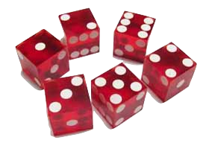
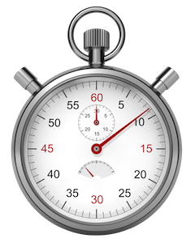
Does everyone have a test plan?
Get into groups of three.
Explain:
How did you test your program?
strategy
organization
results
how did write for “Alice”?
look for similarities and differences

Slide 3
What did you learn from your peers?

Slide 4
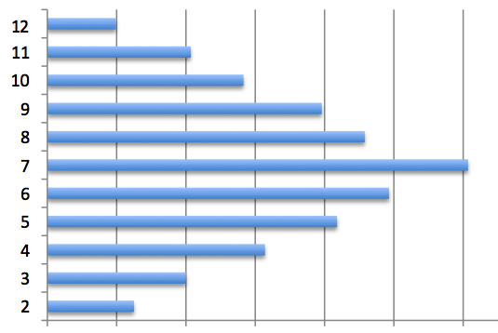
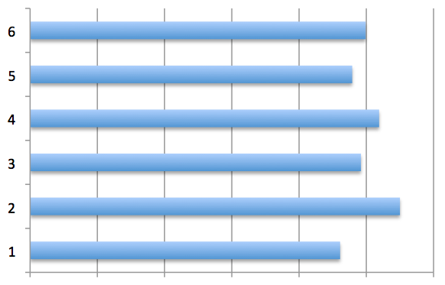
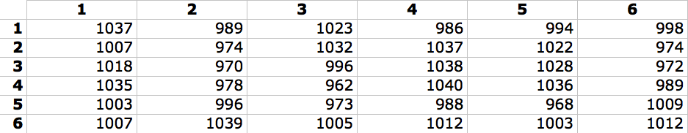
Did you test for...
Histogram for single die (N rolls)
Histogram for two dice (totals)
Chart for two dice (rolls)
Doubles 1/6th of the time

Slide 5
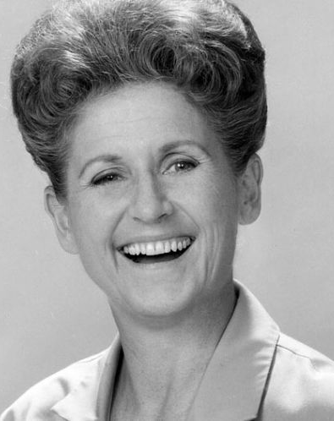

Did you test for...
1
2
3
4
5
6
1
2
3
4
5
6
1
2
3
4
5
6
1...
Independence?
How so?
What if the rolls looked like this?
Would Alice look at those
end results, and say your
program had passed?
Your distributions
were perfect!

Slide 6



HAVE YOU SEEN ME?
REQUIREMENTS
ARCHITECTURAL DESIGN
COMPONENT DESIGN
CODING
TESTING
What is this wrong with this model?
From a tester’s perspective?
What is this called?

Slide 7
HAVE YOU SEEN ME?
REQUIREMENTS
ACCEPTANCE TESTING
ARCHITECTURAL DESIGN
SYSTEM TESTING
COMPONENT DESIGN
INTEGRATION TESTING
CODING
UNIT TESTING
TESTING

Slide 8
The V-Model
REQUIREMENTS
ACCEPTANCE TESTING
ARCHITECTURAL DESIGN
SYSTEM TESTING
COMPONENT DESIGN
INTEGRATION TESTING
CODING
UNIT TESTING
DEVELOPMENT
TESTING
From a planning perspective, the flow goes from top to bottom.
From an execution perspective, the flow goes from left to right.
Question: Why do they call it the “V-Model”?
Question: Which way does time flow?

Slide 9
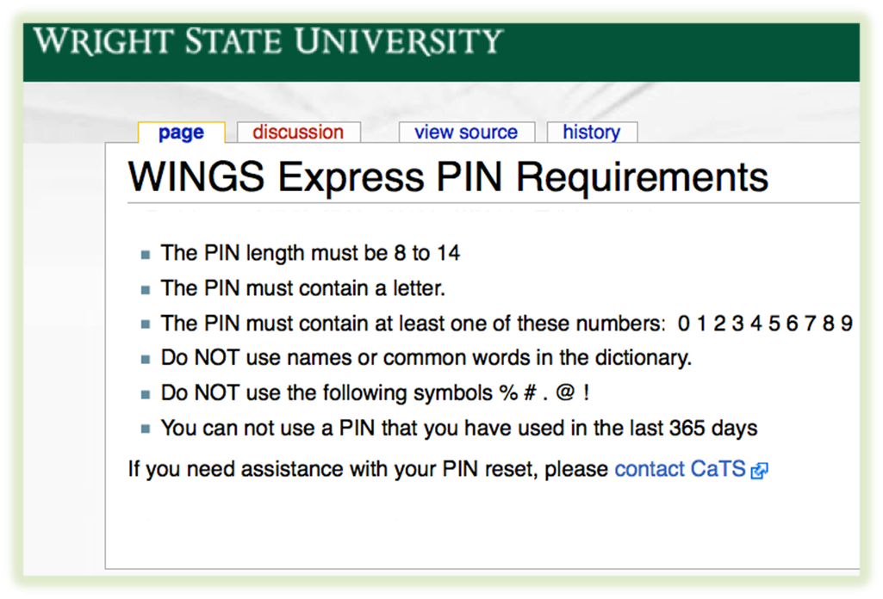
Scenario: Password Checker Program
Password Security Requirements
Would you
need to
write any
code to
draft a test
plan for...?
This last one demonstrates an advantage to V-model development....

Slide 10
Scenario: Password Checker Program
Password Security Requirements:
1. Passwords must be at least 9 characters long.
2. Each password must contain:
At least two upper-case letters
At least two lower-case letters
At least two numerals
At least two special characters
3. Passwords cannot contain blank spaces.
4. New passwords cannot be similar to any
of the user’s three previous passwords.
What is the first question
I am going to ask you?
What are the
requirements?
What are the two places
where the requirements
get tricky?
What is a special character?
Is a comma a special character?
What about a double quote (")?
What about a smart quote (“)?
What about letters like å, ç, é, or ñ?
What about Greek letters, like θ or β ?
What about Arabic letters, like س?
What is a “similar to”?
Assume old password is ABcd12$#
What about...
ABcd12$@
BAdc21#$
#$21dcBA
Bcd12$#A
BCcd12$@
abCD12$@
Your mission is to derive a set of test cases to test the Password Checker Program
But for the HW1 assignment, we will only consider Requirement Nos. 1 thru 3

Slide 11
HW Assignment 1
Password Checker Program
For this assignment, assume passwords must adhere to the following standard:
The system shall reject any new password that:
does not have a minimum of 2 upper-case letters
2) does not have a minimum of 2 lower-case letters
3) does not have a minimum of 2 numerals, 0-9
4) does not have a minimum of 2 special characters, which include the following:
Also, a new password shall be rejected if it:
5) is not at least 9 characters long, or is more than 24 characters long
6) contains one or more blank spaces.
You are to write a test plan testing these requirements, V-Model style.
Each test case should include a proposed password, and indicate whether the program will accept or reject the password.
Make sure the test plan is organized such that the reader knows which requirement is being tested with each test case.
Hint: I would expect your test plan to consist of eight test cases.

Slide 12
Questions?

Slide 13
This slide intentionally left blank

